Slide 1

Functional Programming In F#
Is it a fad?
Or…

Slide 2


Slide 3
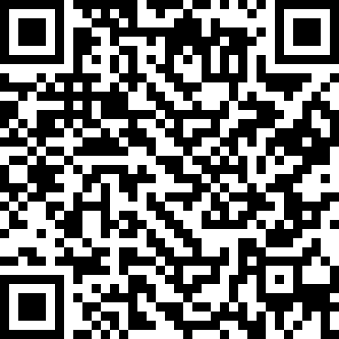
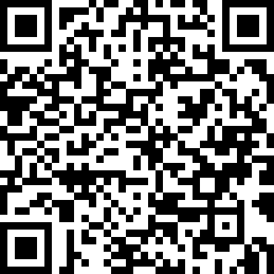
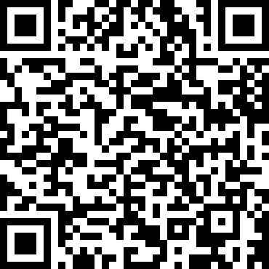
Who is Ken Bonny?
Freelance
architect
team lead
coach
developer
I blog at kenbonny.net
Follow me on Bluesky @kenbonny.net

Slide 4
What am I talking about
The technology: F# and Wolverine
Functions & types
Computational expressions
Discriminated unions
Pattern matching
Piping
Message handling
Testing

Slide 5
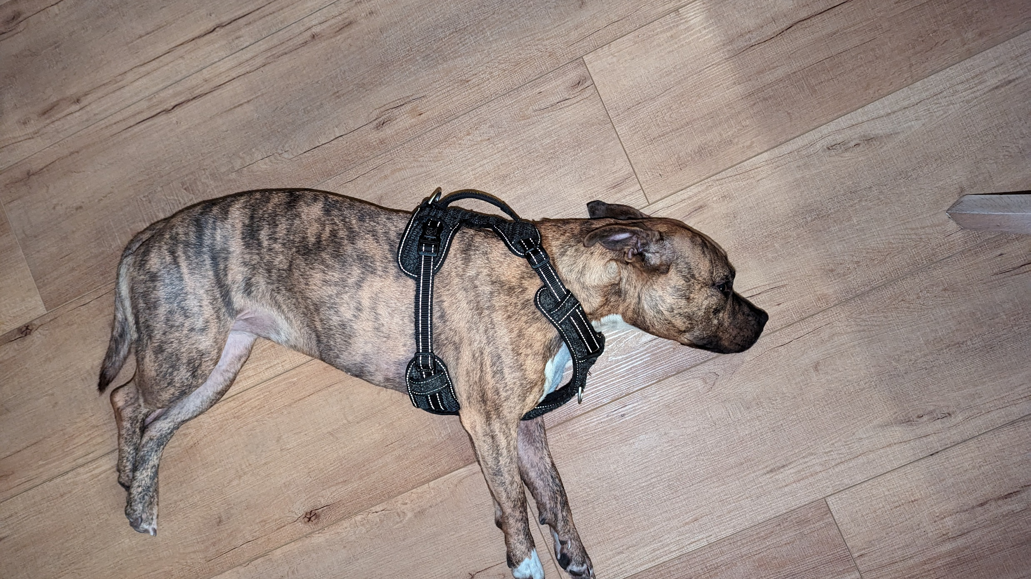
Notes:
Do not despair like my dog when she is deprived of constant attention and cookies
Most of the terms I used sound scarier than they are
The most difficult one is computational expressions and that is only true when you want to create them

Slide 6
Demo application
Drone flight tracking app
Overly simplistic
Nice showcase of what F# can do

Slide 7
The technology
F#
Functional first, OO second
Less boilerplate, concise
Dotnet ecosystem compatible
Scripting capabilities
Order is important!
Wolverine
Messaging first
Minimalistic, yet extendable
Reliable
Easy to understand
Convention over interfaces!

Slide 8
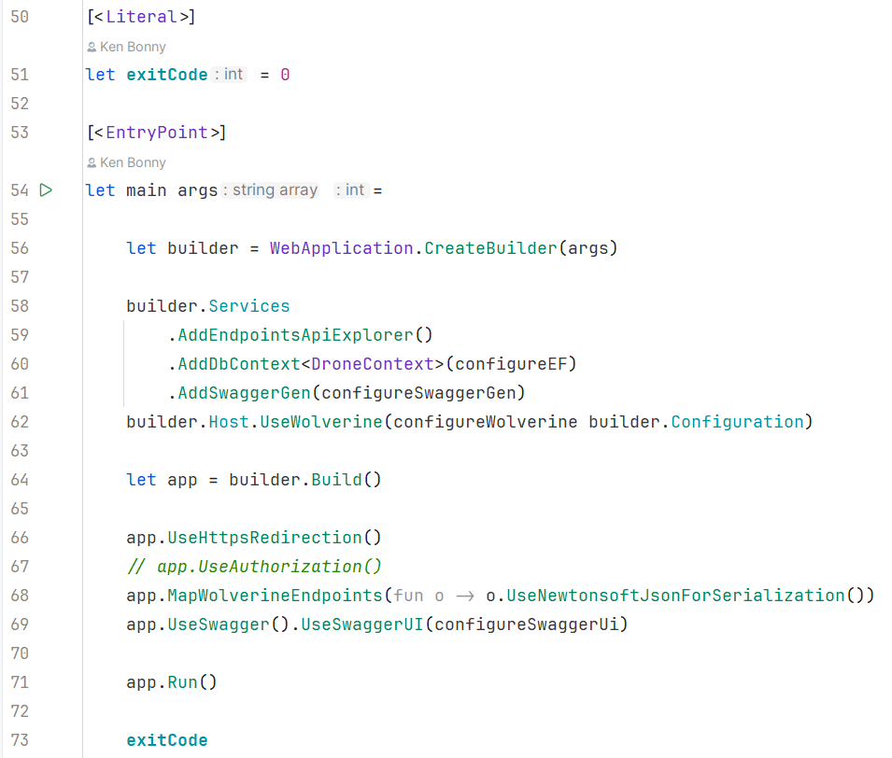
The API setup
Notes:
Order is important
Function and value creation with let
Partial application of a function
F# is full of nice little tricks like this

Slide 9
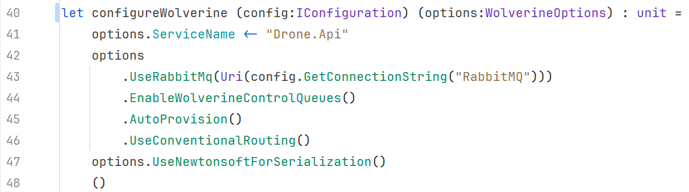
The API setup
Notes:
Order is important
Function and value creation with let
Partial application of a function
F# is full of nice little tricks like this

Slide 10
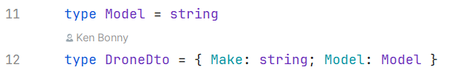
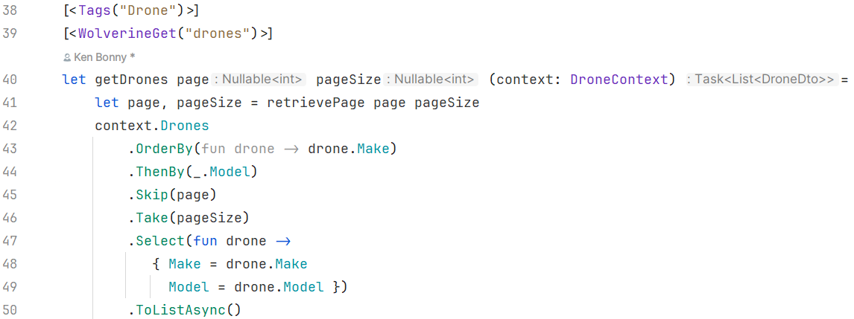
Retrieving a list of drones
Notes:
Model is a type alias, more descriptive than a regular string
Reassign page and pageSize values, not mutation!
Can be used in model binding and return values
Plays nice with entity framework
Wolverine specific attributes
- Tags for swagger grouping
- get for the path
Page + pageSize are query params
DroneContext is injected
Wolverine uses static functions and F# functions translate to those
Wolverine uses specific DI container called Lamar that allows this

Slide 11
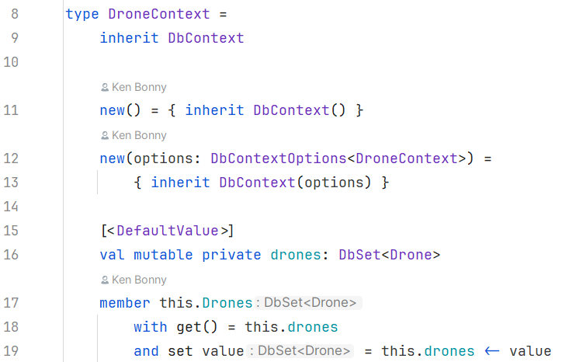
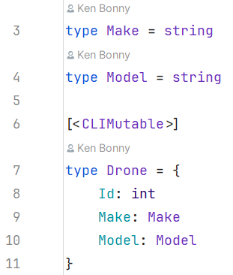
EF setup
Notes:
Pretty straightforward creation of a class
More code than auto properties from C#
Solved with a template
All table definitions need either mutable properties/fields
Or the entire type needs the [CLIMutable] attribute
This allows the runtime to modify the properties/fields, but in code the compiler will still treat it as immutable values

Slide 12
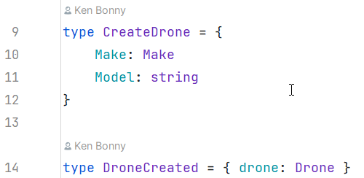
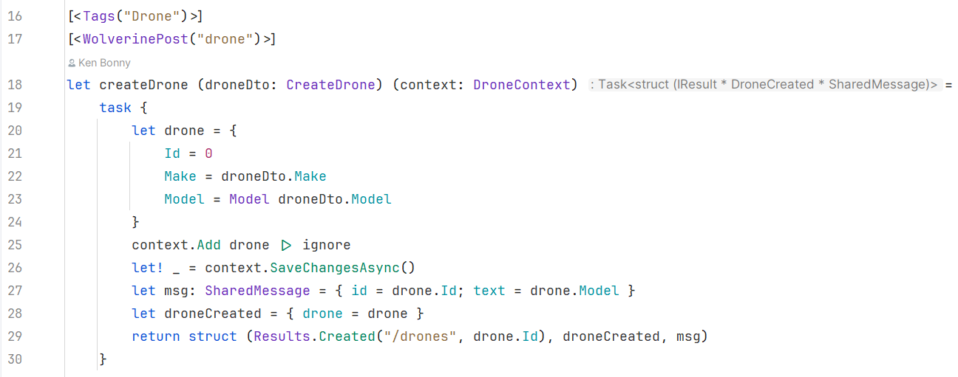
Creating a new drone
Notes:
CreateDrone is the DTO the endpoint will accept
DroneCreated is one of the messages we will send through Wolverine
The attribues will be familiar
The DTO will nicely be deserialised by the framework and the context injected
But now we get to something interesting: task {}
Called computational expression, used for all sorts of computations, this case: await
That is what the let! (pronounced let bang) does: in the context of the task, it acts as the await keyword in C#

Slide 13
Computational Expressions
Convenient syntax for writing computations that can be sequenced and combined using control flow constructs and bindings
Allows us to add language features and DSL components
In task context, let! or do! is equivalent to await in C#
Notes:
That is what the let! (pronounced let bang) does: in the context of the task, it acts as the await keyword in C#

Slide 14
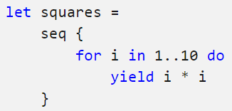
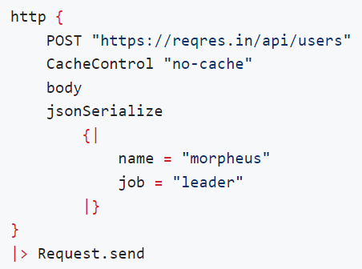
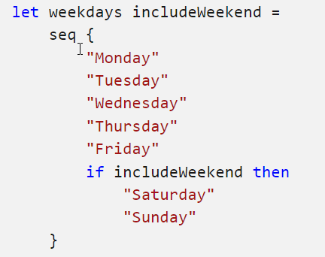
Examples
Seq
FsHttp
Notes:
Seq is the equivalent of Ienumerable
Can contain conditional logic
Can be used as a DSL (Domain Specific Language) such as for http requests

Slide 15

Notes:
If I read the room right, you all resemble my sceptical dog
I’ve shown several nice F# features
But nothing that can dethrone C# just yet
Let me present to you where F# shines

Slide 16
What is a flight
It’s a drone that will fly a certain route
I will ignore
Dates
Flight speed
Altitude
Focus on the data processing, not real-world complexity

Slide 17
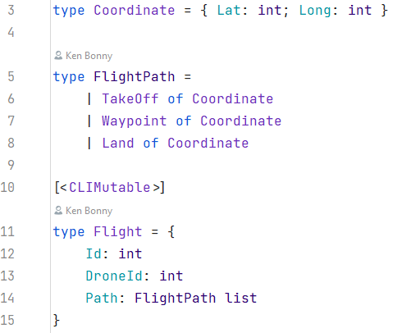
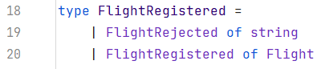
What is a flight
Notes:
Most important part here is the Discriminated Union that is named FlightPath and has 3 possible values: a place where it takes off, a place where it land and all waypoints in between

Slide 18
Discriminated Unions / Sum or Union Types
Values that can be one of several named cases
Each case can have its own type or value
Good for
Commands & domain concepts
Special cases with a limited set of options
Error cases
Handle each case with pattern matching
Warning when not handling a case
Avoid catch all patterns

Slide 19
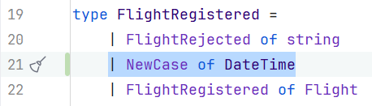
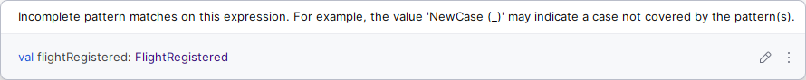
Discriminated Unions / Sum or Union Types
Notes:
When we add a case, the compiler will tell us where we need to update our code
It does this as a warning
I advise to treat them very seriously as this is a good indicator where bugs or missing feature are
Rider (and I assume Visual Studio too) have quick fixes to add the missing patterns

Slide 20
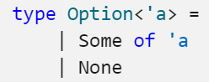
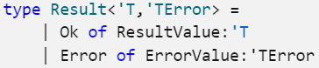
Famous examples
Option
Result
Equivalent Nullable<T>
Much safer
Used in algorithms

Slide 21
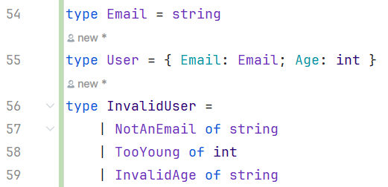
Railway-Oriented Programming
Notes:
Code the happy path
Exit when an error is encountered

Slide 22
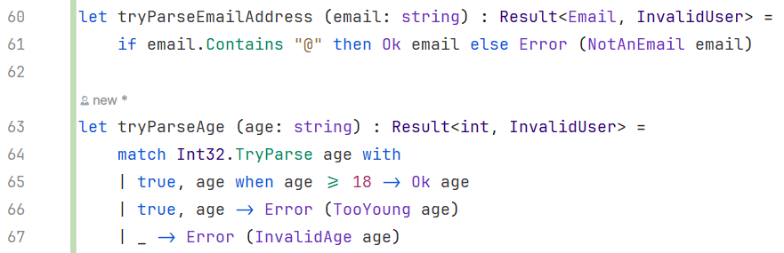
Railway-Oriented Programming
Notes:
Code the happy path
Exit when an error is encountered

Slide 23
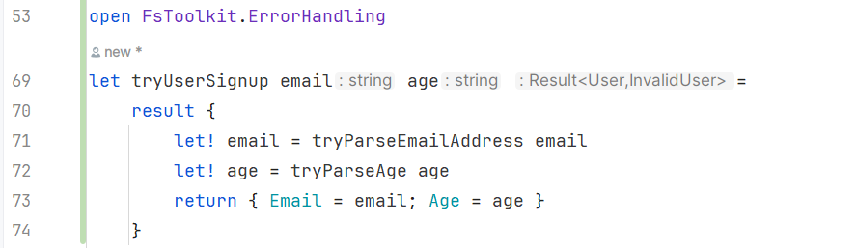
Railway-Oriented Programming
Notes:
Code the happy path
Exit when an error is encountered

Slide 24
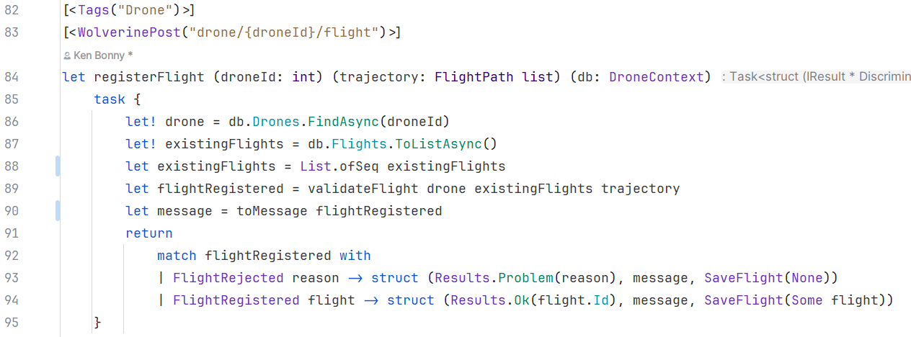
Register a flight
Notes:
Attributes, computational expressions and let! hold no more secrets
Below the return is a match statement as the validate flight returns a FlightRegistered DU
The match statement helps determine what we have to do in each scenario
Not much room for bugs or errors

Slide 25
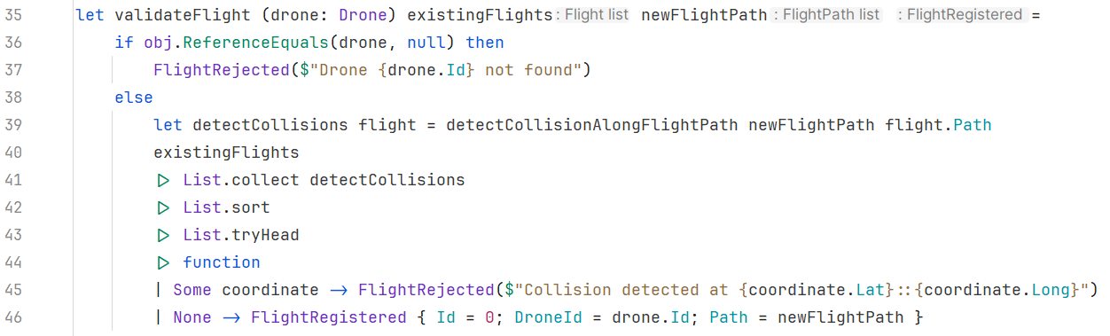
Validating the flight
Notes:
Wow, a lot is going on here, let’s unpack
Null check is a bit more complex as this is not normally done in F#
Normally, a Nullable<T> is returned which can be transformed into an Option and then pattern matched on that
The tryHead function at the bottom is an excellent example
it’s the FirstOrDefault Linq equivalent: empty list returns none, non-empty list returns the first item
Next is a function > this is a shorthand that crates a function with one parameter and automatically creates a pattern match
Could easily be written as such, but there is a shorthand as this is used a lot in F#

Slide 26
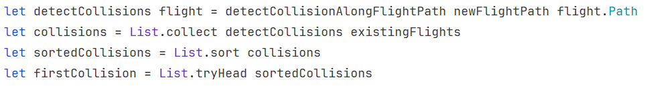
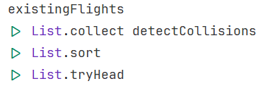
Piping
Piping enables chaining function calls together as successive operations
Pass the output of the previous function as the last input of the next

Slide 27
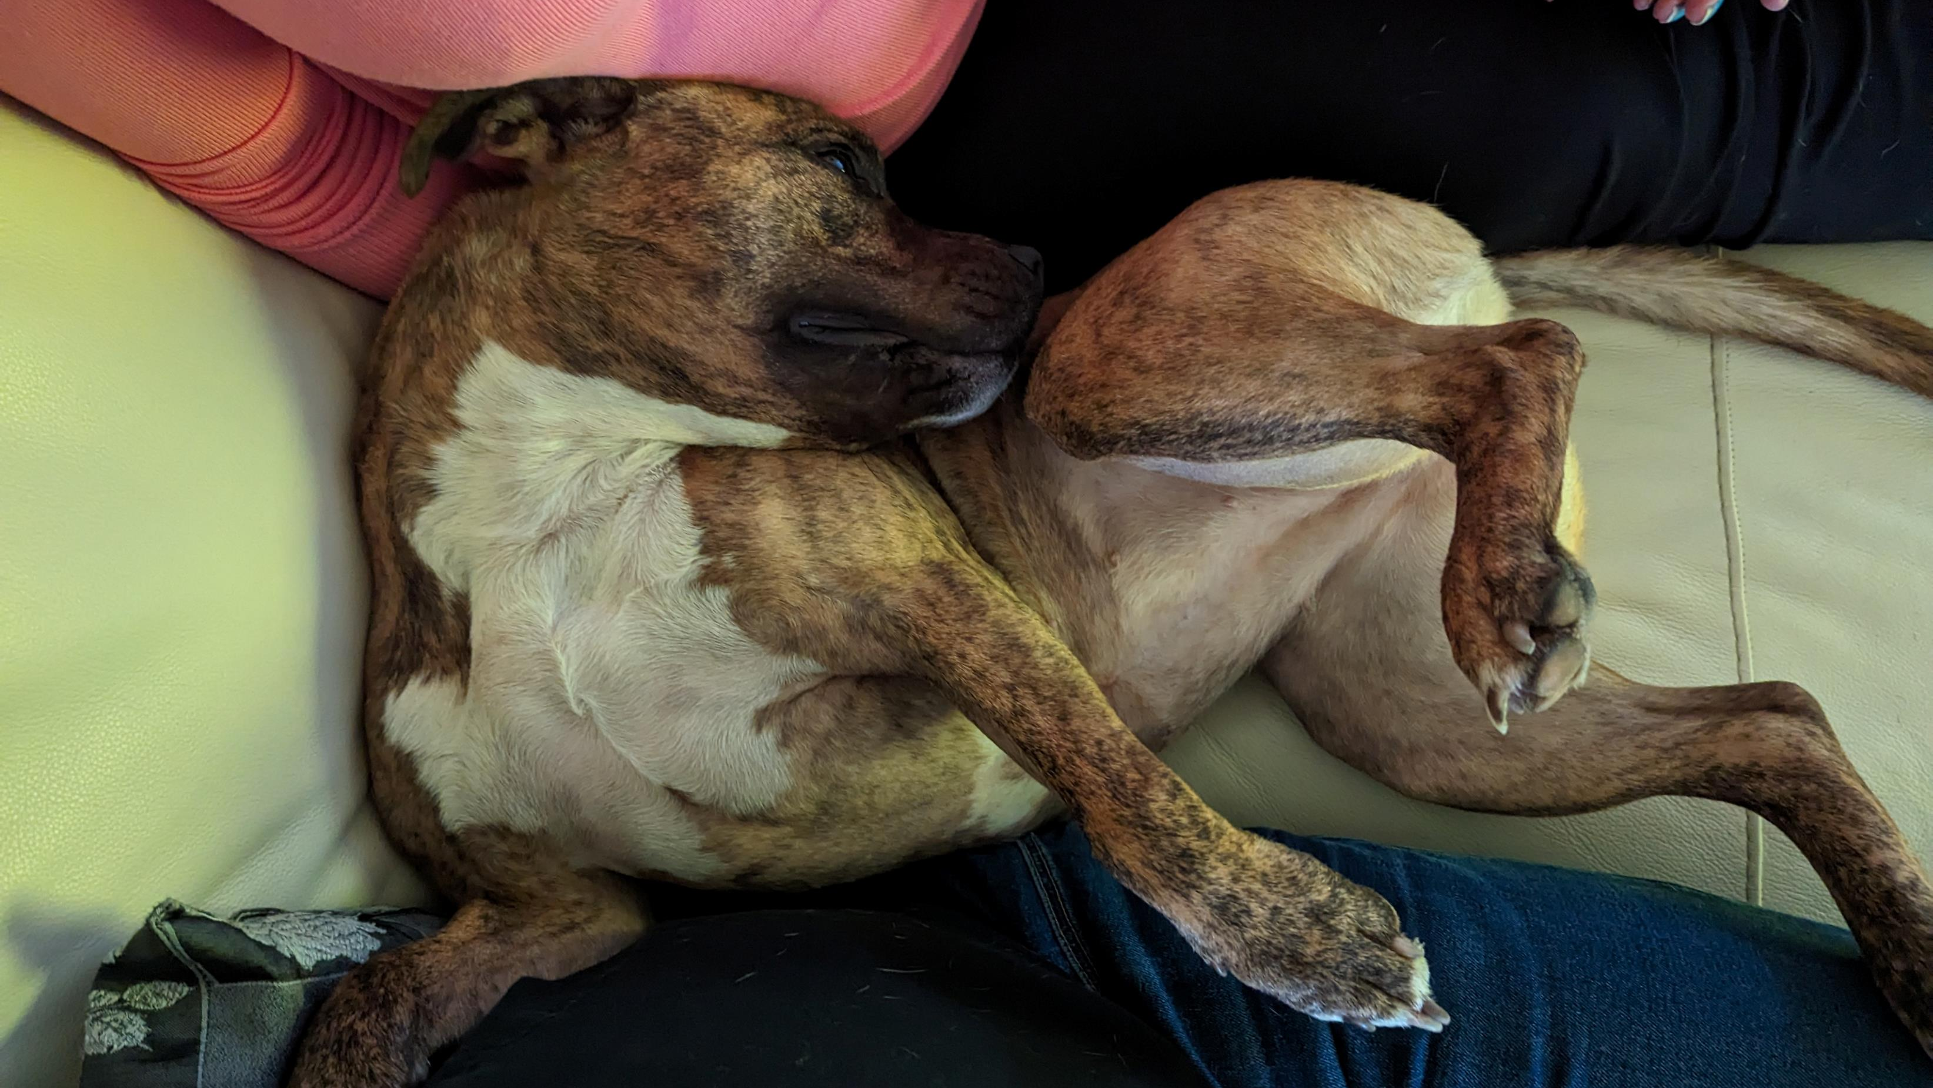
Notes:
When you see the implementation, you can see how compact yet readable the code is
Just like my dog who tries to be as compact as possible

Slide 28
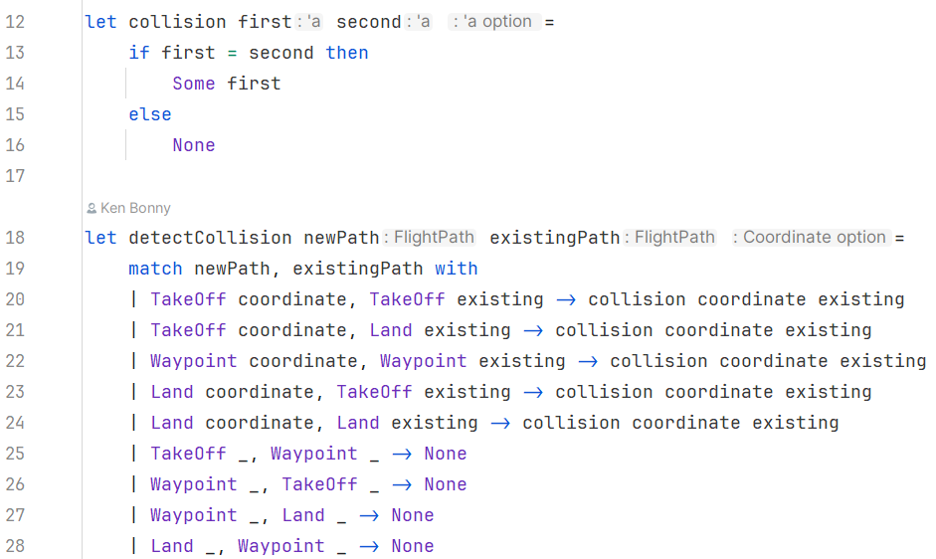
Detecting a collision
Notes:
Detecting a collision then becomes quite easy
The helper function can easily detect if they are the same, as records automatically implement value equality
The detectCollision on the other hand lists out every possible match between the two discriminated unions
Only during certain scenarios do we need to check for a collision
And all those scenarios are literally spelled out for us
Since all scenarios are spelled out, it’s quite difficult for a bug to hide in here
This is why F# is such a good language
Not saying that it’s easy and certainly not a lot of work
But less so than in a language where you can’t do this

Slide 29
With great power, come disadvantages
Not widely supported in serialisation
Newtonsoft.Json
No EF support
Custom value conversion
Need to map when interacting with C# code
Message in memory work fine
Message through a bus needs
Newtonsoft.Json as serialisation
Wrap the DU in a generic envelope
Notes:
Unfortunately, there are some drawbacks to Discriminated unions
Serialisation support is difficult: System.Text.Json (Microsoft’s out-of-the-box library for serialising to JSON) does not have support for DU’s
And as far as I know, is not planning on adding it
That is why I use Newtonsoft.Json
EF has no support for DU’s
They need custom value converters to save and load the data from a database
When returning this to a C# library, you’ll need to map it
My recommendation is to map it to a hierarchy that matches the DU
Result DU to abstract Result with Ok and Error inherited types.
Sending DU’s through Wolverine works fine in a local scenario
When sending through a bus (Azure or RabbitMQ), it needs to use the Newtonsoft.Json serialisation
And wrapped in a generic envelope
This is because Wolverine looks for a method taking the specific DU case instead of a method taking the DU

Slide 30
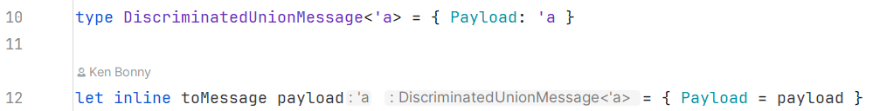
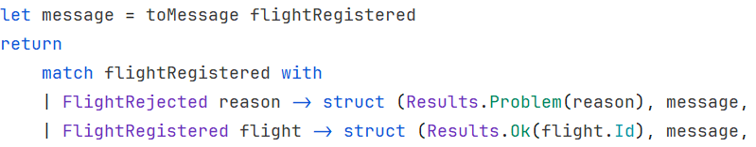
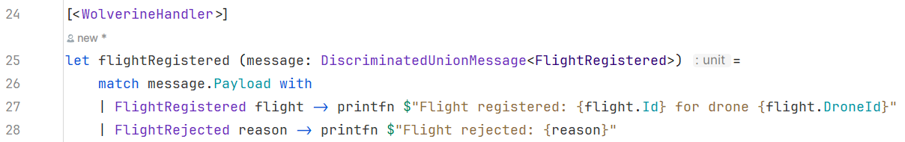
Register a flight
Notes:
The first 2 lines show what the envelope looks like
Together with a function to easily wrap any type into the envelope
On line 87, I wrap the message in a generic type so that it can nicely be routed to the correct handler methods
And then I send it through Wolverine to be routed to the handling message
The handling doesn’t do much in itself, but it shows that the message is received correctly

Slide 31
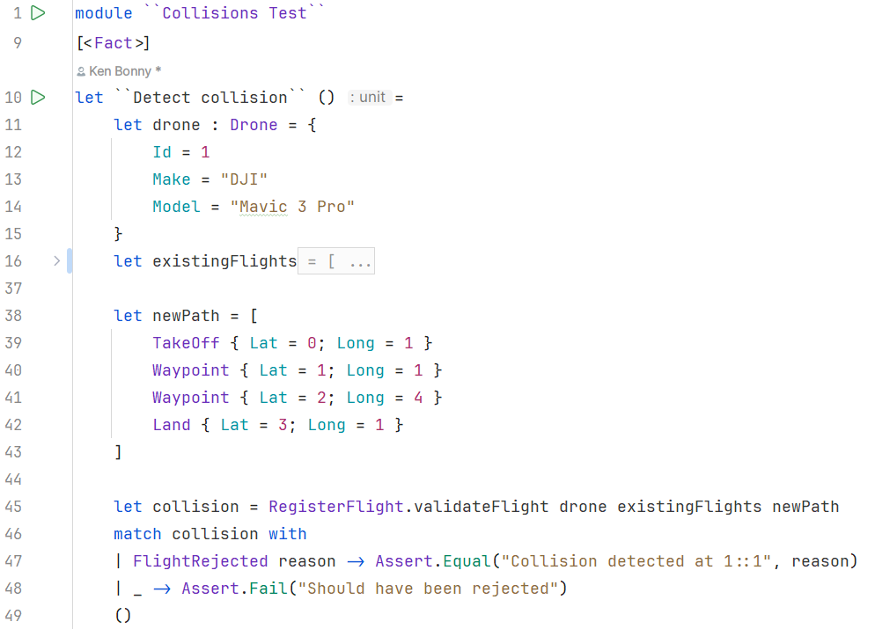
Testing it all
Notes:
For automated tests, I just use xUnit, set up data, feed it to the validation logic and discriminated unions make it easy to check what case I get back
Another little fun feature of F#, I can write function names between double backticks and make it a sentence
I wouldn’t use this for functions I would need to type a lot, because they always need to go between double brackets
But for tests this means no more snake or camel case

Slide 32
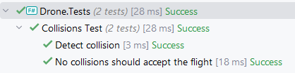
Testing it all

Slide 33
Summary
F#
Functions & types
Discriminated unions
Pattern matching
Piping
Computational expressions
Start with scripts
Notes:
It goes a lot deeper
F# patten matching has only scratched the surface
Wolverine also has advanced features such as retries, error handling and sagas

Slide 34
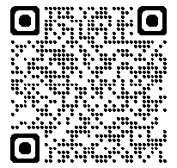
GitHub Repository

Slide 35
Is |> a keyword?
Notes:
I want to end on a fact that blew my mind: who thinks the piping symbol is part of the fsharp language
Much like let or fun are keywords
It’s not!
It’s an operator that is defined in the standard library
Basically, it’s an ordinary function
This is what you get when you do language design right, you get awesomely simple features like this from functionality available in the language, not baked into the language
One of the most used constructs in the language is not part of the language itself
It’s a consequence of good language design

